Slide 1
Time Series Case Study Retail-Giant Sales Forecasting
Group Members :
Oshin Sharma
Chirag Sharma
Pranav Haldar
Nupur Gupta

Slide 2
Overview
Background of Problem “Global Mart” is an online store giant with worldwide operations. It takes orders and delivers across the globe and deals with 7 market segments and 3 major product categories - consumer, corporate & home office.
Company Business Objectives
Evaluate 21 segments (7*3) on sales, quantity and profit
Find out 2 most profitable (and consistent) segment from these 21 and forecast the sales and demand for these segments for next 6 months
Aim The aim of study is to leverage available data to visualize using time series and build models to forecast sales for next 6 months as accurately as possible so that inventory and revenue planning can be done efficiently

Slide 3
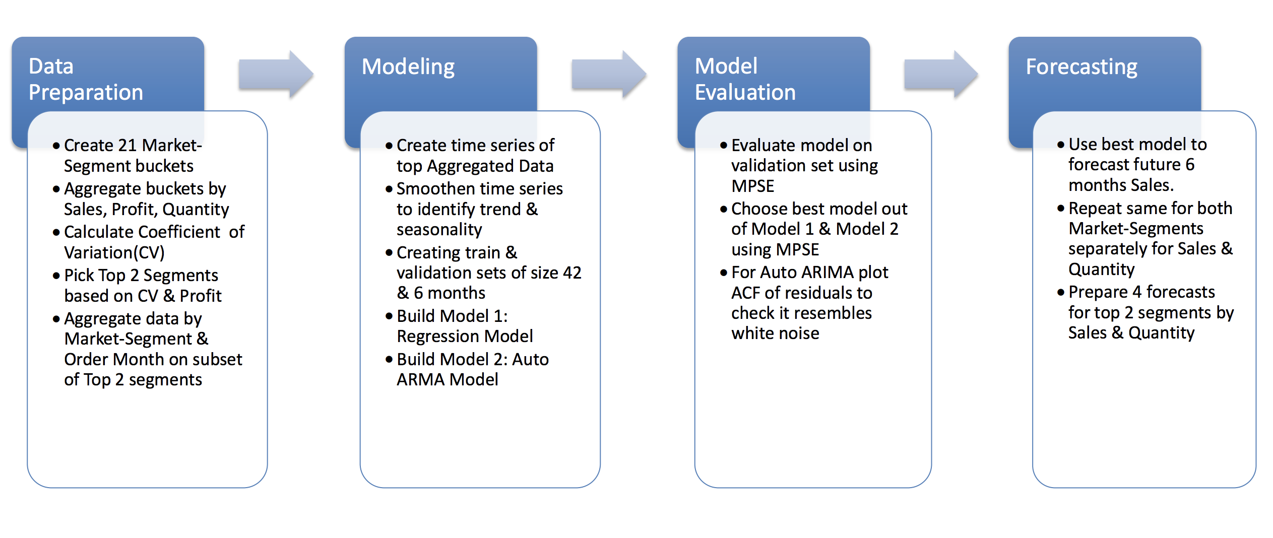
Problem Solving Methodology

Slide 4
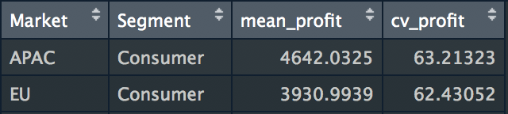
Data Preparation and EDA
Created 21 data subset buckets based on Market & Segment and aggregated by sales, Qty and Profit
Calculated Coefficient of Variation(CV) on aggregated Profit for each Market-Segment using: CV = sd(Profit)*100/mean(Profit)
Using CV and Profit numbers, top 2 most profitable segments are APAC – Consumer and EU – Consumer
Extract Order month
Aggregated data by market segment and order month

Slide 5
Model Building – Regression and Auto ARIMA
Created time series for aggregated data of EU_Consumer & APAC_Consumer subsets for first 48 months
Smoothened time series using Moving Average method, also tested Holt Winters smoothing
Time series data was divided into train(1-40 month), validation(41-48 month) & test sets(49-54 month)
Model 1: Linear model : Created using tslm() function from forecast package in R on train data
Model 2: Auto Arima Model: Created using auto.arima() function from forecast package in R train data
Both models were evaluated using Mean Absolute Percentage Error(MAPE)
ACF plots of residuals were used check that it resembles white noise

Slide 6
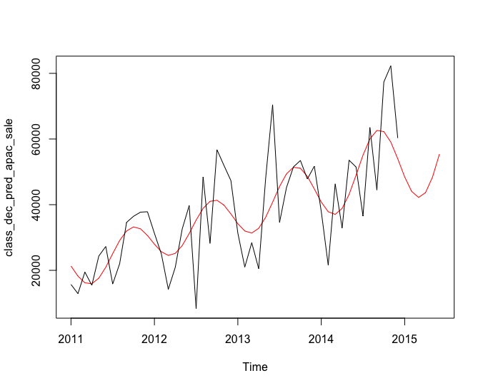
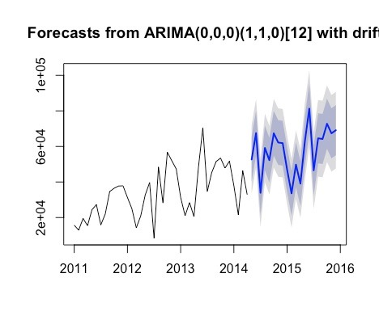
APAC - Consumer Sale Forecasting
Classical Decomposition
Auto ARIMA
MAPE: 0.21
MAPE: 0.13

Slide 7
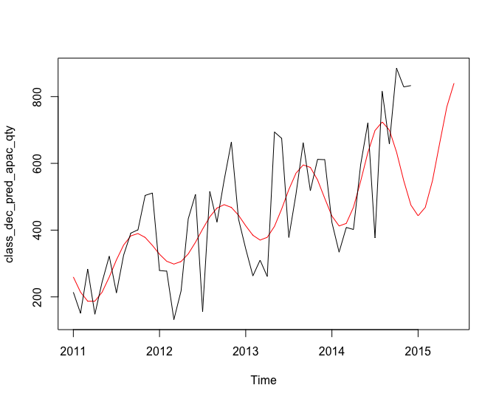
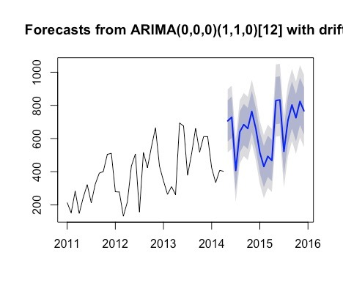
APAC-Consumer Quantity Forecasting
Classical Decomposition
Auto ARIMA
MAPE: 0.31
MAPE: 0.15

Slide 8
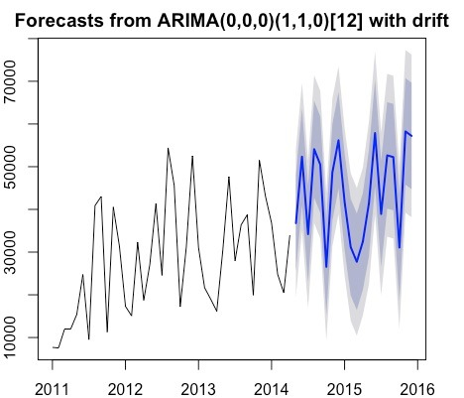
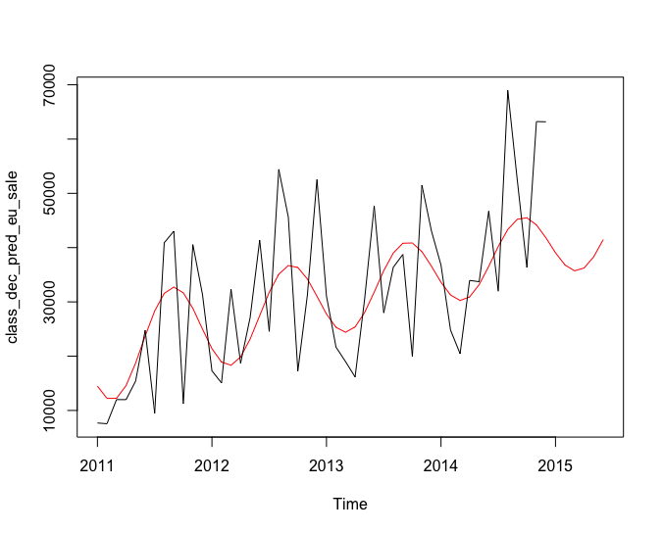
EU - Consumer Sale Forecasting
Classical Decomposition
Auto ARIMA
MAPE: 0.298
MAPE: 0.169

Slide 9
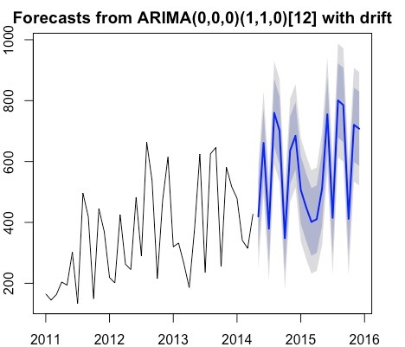
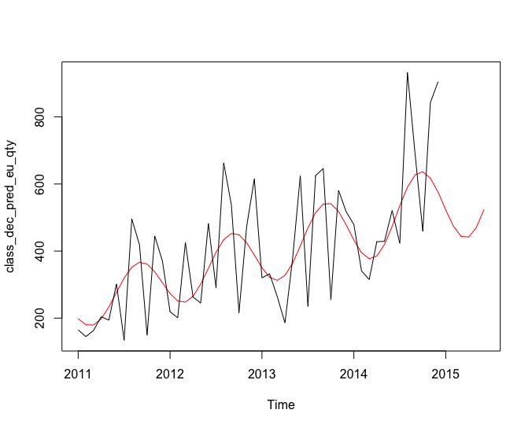
EU - Consumer Quantity Forecasting
Classical Decomposition
Auto ARIMA
MAPE: 0.27
MAPE: 0.195

Slide 10
Conclusion
Annual Seasonality of Retail data is clearly modelled by both classical decomposition and ARIMA time series forecasting.
Auto ARIMA has significantly lower MAPE values for all time series predicted than classical decomposition method. Thus, Auto ARIMA model has given better forecasted values.
Forecast values of Quantity and sales:

